Slide 1
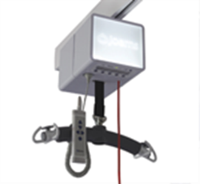
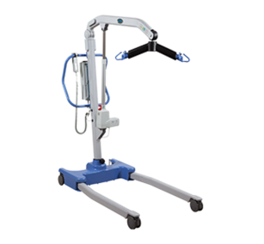
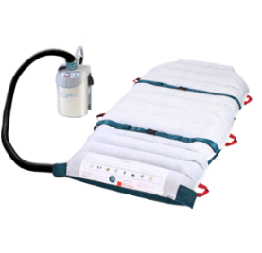

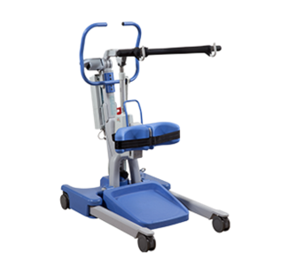
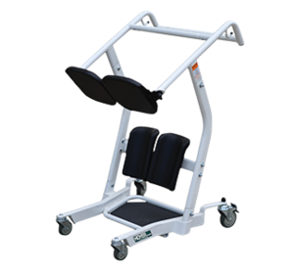
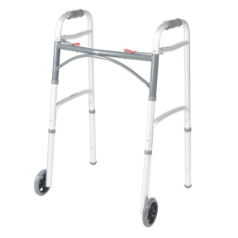
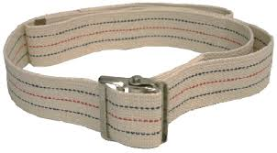

Level 1
SIT & SHAKE
Safe Patient Handling Bedside Mobility Assessment Tool (BMAT)
BMAT Level
Ability
Equipment
LEVEL OF INDEPENDENCE
Dependent:
on bedrest
unable to assist
weakness throughout all extremities,
unable to sit up
Ceiling or total lift
Air assist device or PATRAN sheet
Level 2
STRETCH & POINT
Moderately Dependent: can come to a seated position but cannot get up, able to bend/flex ankle and point toes (with at least with one leg)
Ceiling or portable lift
Air assist device or PATRAN sheet
Mechanical Sit- Stand
Level 3
STAND
Minimum Assistance: able to bear weight, may need physical assistance
Gait Belt
Manual Stand-aid
Walker or assistive device
Level 4
MARCH & WALK
Independent: able to stand from seated position and walk independently without assistive devices; no known concerns for falling
-None
Your Safety is Our Greatest Concern

