Slide 1
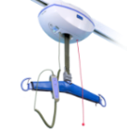
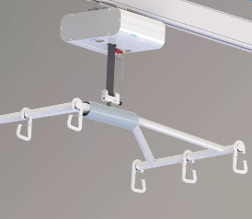
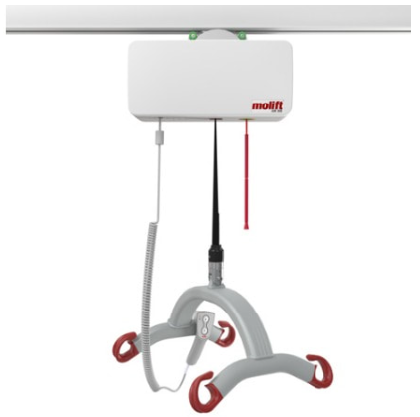
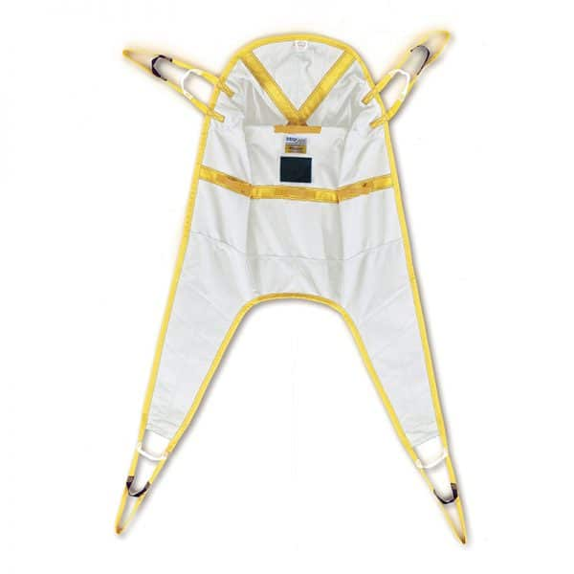
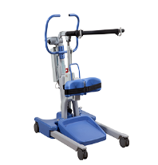
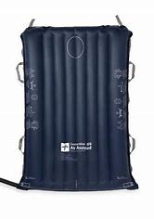
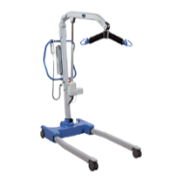
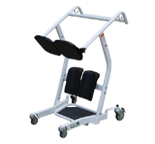
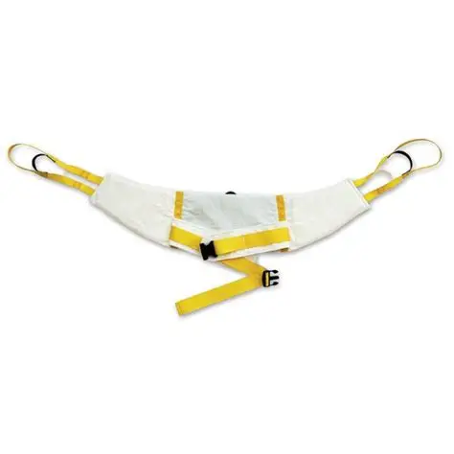
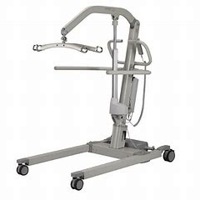
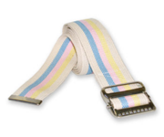
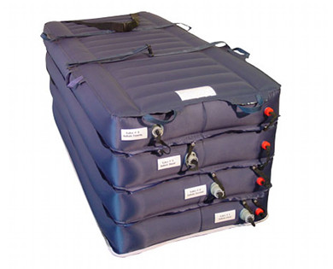
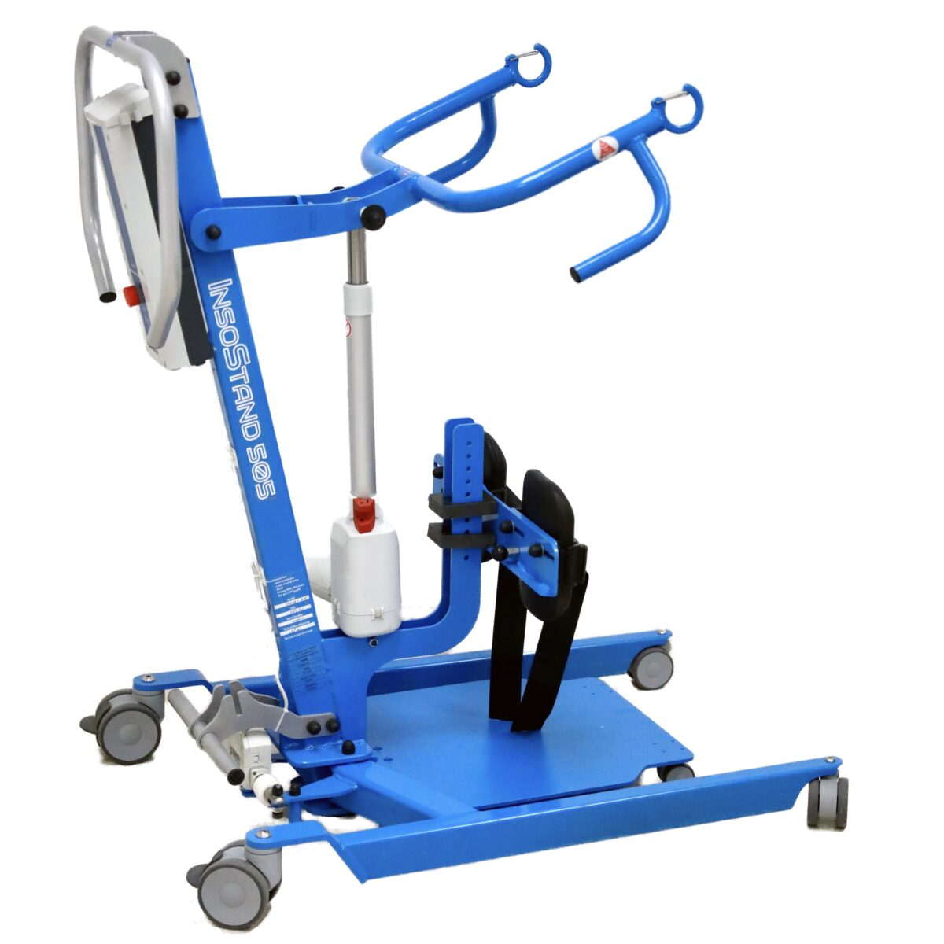
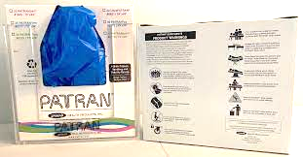

Safe Patient Handling and Mobility Quick Reference Guide
Sit- Stand Slings
Bariatric Equipment Rentals
Weight limits may vary: Check each piece of equipment for weight capacity prior to use
Air-Assist Devices:
Lifts:
Sit to Stand :
Slings:
Bariatric Equipment Rentals
Canisters: Unit-Specific
Matts: Single-Patient Use- in clean utility or Request from Store room
Ceiling Lifts
*know capabilities of patient prior to use
Universal Slings
Mechanical Sit- Stand
Contact the vendor (Agiliti) to arrange for delivery.
Bariatric Equipment
for Rent:
Beds
Mattress (low air loss pulsate, immerse, or OOK)
Chairs
Commodes
Walker
Comfort Glide
600 or 1000 lb capacity. In ICU.
Lateral transfer, boosting, turning/repositioning
Full Mechanical Lifts
350- 440 lb capacity. On most Patient care units.
Slings in clean utility rooms.
Available through Store room or in clean utility rooms
475, 600 or 700 lb capacity. On most Patient Care units. Slings in clean utility rooms.
Manual Stand Aids
- 1000 lb capacity
- Transfer at an angle(hand off method) when possible
Bariatric Hoyer Lift
Hover Jack
Gait Belts:
Lift patient from floor to bed
350- 450 lb capacity
Locations: Patient care units
Bariatric Sit to Stand
Patran Slide sheet:
Located in most patient care units
Available through Store room on in clean utility rooms
1200 lb capacity. In Nursing Admin office, ED, 3E, and CCC.
Location:
Storeroom and patient care units
800 lb capacity. Materials Management or 3rd floor.
For any Safe Patient Handling and Mobility Concerns, please email: Kim Alger or check with your SPH unit representative.

